Slide 1
ECE 532
CHAPTER 4: GRAPHS (PART 2: Depth-first search, Breath-first search)
Lecturer: Dr. Roslina Mohamad
Room: Tower 2, Level 13, No:14C

Slide 2
Learning Outcomes
In this chapter, you will:
Examine and implement various graph traversal/searching algorithms

Slide 3
Searching a Graph
Recall that with a tree we search from the root
But with a digraph …
may not be a vertex from which every other vertex can be reached
may not be possible to traverse entire digraph (regardless of starting vertex)

Slide 4
Searching a Graph
We must determine which nodes are reachable from a given node using traversal algorithm
Traversal Given G=(V,E) and vertex v, find all w∈V, such that w connects v
Two standard methods of searching:
Depth First Search (DFS): preorder traversal
Breadth First Search (BFS): level order traversal

Slide 5
Depth-First Search
Start from a given vertex v
Visit first neighbor w, of v
Then visit first neighbor of w which has not already been visited
etc. … Continues until
all nodes of graph have been examined
If dead-end reached
backup to last visited node
examine remaining neighbors

Slide 6
Depth-First Search
DFS uses backtracking when necessary to return to some values that were
already processed or
skipped over on an earlier pass
When tracking this with a stack
pop returned item from the stack
Recursion is also a natural technique for this task
Note: DFS of a tree would be equivalent to a preorder traversal

Slide 7
Depth-first search for Digraph
Depth-first search: Strategy (for digraph)
choose a starting vertex, distance d = 0
vertices are visited in order of increasing distance from the starting vertex,
examine One edges leading from vertices (at distance d) to adjacent vertices (at distance d+1)
then, examine One edges leading from vertices at distance d+1 to distance d+2, and so on,
until no new vertex is discovered, or dead end
then, backtrack one distance back up, and try other edges, and so on
until finally backtrack to starting vertex, with no more new vertex to be discovered.

Slide 8
Depth-First Search
Algorithm to perform DFS search of digraph
1.
Visit the start vertex, v
2.
For each vertex w adjacent to v do:
If
w
has not been visited,
apply the depth-first search algorithm
with
w
as the start vertex.
Note the recursion and stack

Slide 9
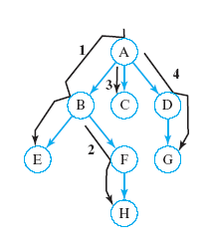
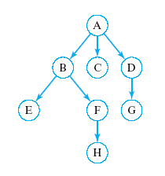
Depth-First Search
Start from node 1
What is a sequence of nodes which would be visited in DFS?
Click for answer
A, B, E, F, H, C, D, G

Slide 10
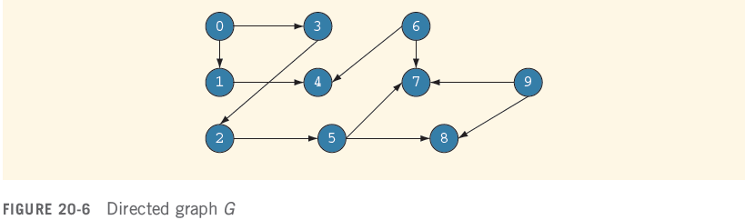
Depth First Traversal
Depth-first ordering of vertices:
0, 1, 4, 3, 2, 5, 7, 8, 6, 9

Slide 11
Depth-First Search on Undirected Graphs
Depth-first search on an undirected graph is complicated by the fact that edges should by explored in one direction only,
but they are represented twice in the data structure (symmetric digraph equivalence)
Depth-first search provides an orientation for each of its edges
they are oriented in the direction in which they are first encountered (during exploring)
the reverse direction is then ignored.

Slide 12
How to do depth-first searching
Put the root node on a stack; while (stack is not empty) { remove a node from the stack; if (node is a goal node) return success; put all children of node onto the stack; } return failure;
At each step, the stack contains a path of nodes from the root
The stack must be large enough to hold the longest possible path, that is, the maximum depth of search

Slide 13
Depth-first searching
A depth-first search (DFS) explores a path all the way to a leaf before backtracking and exploring another path
For example, after searching A, then B, then D, the search backtracks and tries another path from B
Node are explored in the order A B D E H L M N I O P C F G J K Q
N will be found before J
A
B
C
D
E
F
G
H
I
J
K
L
M
N
O
P
Q

Slide 14
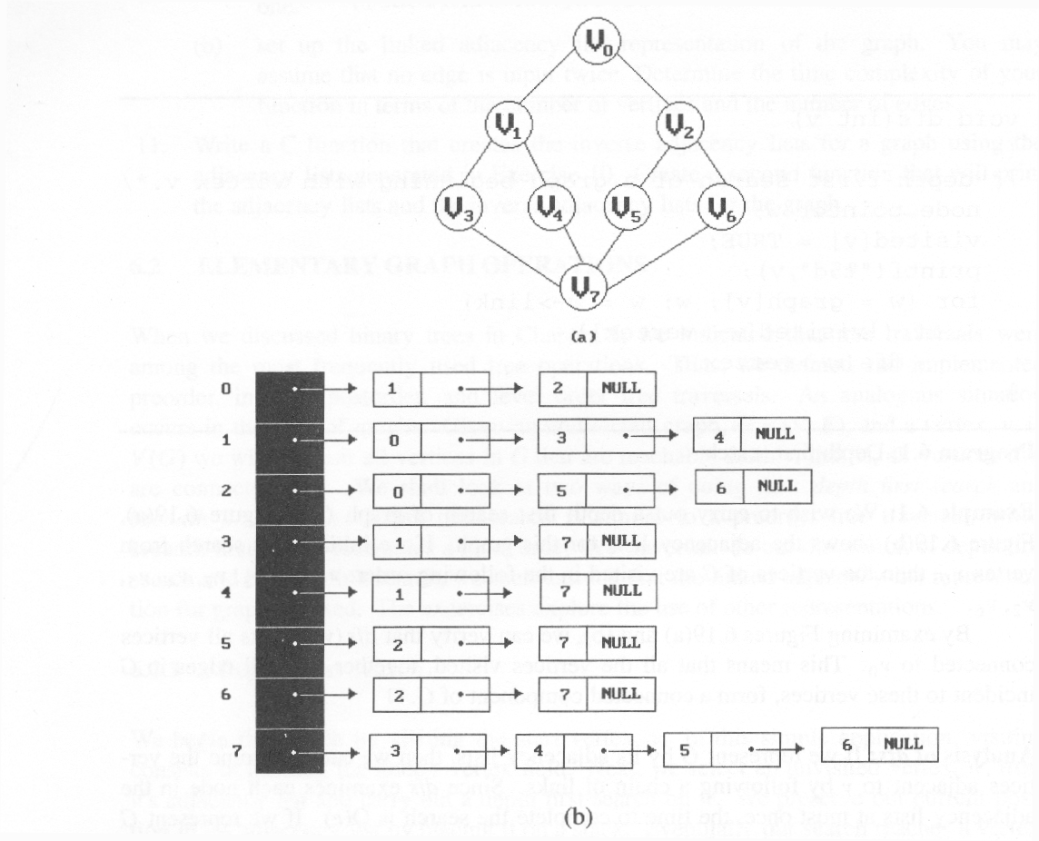
Graph Operations
Example for traversal (using Adjacency List representation of Graph)
depth first search (DFS): v₀, v₁, v₃, v₇, v₄, v₅, v₂, v₆

Slide 15
Example 4.1 //Directed Graph
Example 4.2 //Undirected Graph-Connected
Example 4.3//Directed Graph-Connected
Example 4.4//Directed Graph-Connected
Example 4.5//Directed Graph-Connected
Example 4.6//Undirected Graph-Tree
Example 4.7//Directed Graph-Tree

Slide 16
Breadth-First Search
Start from a given vertex v
Visit all neighbors of v
Then visit all neighbors of first neighbor w of v
Then visit all neighbors of second neighbor x of v … etc.
BFS visits nodes by level

Slide 17
Breadth-First Search
While visiting each node on a given level
store it so that
we can return to it after completing this level
so that nodes adjacent to it can be visited
First node visited on given level should be First node to which we return What data structure does this imply?
A queue

Slide 18
Breadth-First Search-Directed Graph
Algorithm for BFS search of a diagraph
Visit the start vertex
Initialize queue to contain only the start vertex
While queue not empty do
Remove a vertex v from the queue
For all vertices w adjacent to v do: If w has not been visited then:
Visit w
Add w to queue
End while

Slide 19
Breadth- First Traversal
Breadth-first ordering of vertices:
0, 1, 3, 4, 2, 5, 7, 8, 6, 9

Slide 20
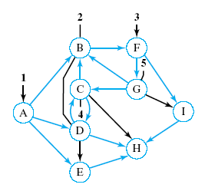
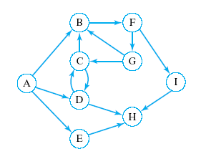
Breadth-First Search
Start from node containing A
What is a sequence of nodes which would be visited in BFS?
Click for answer
A, B, D, E, F, C, H, G, I

Slide 21
Breadth-first Search on Undirected Graph
Simply treat the undirected graph as symmetric digraph
in fact undirected graph is represented in adjacency list as symmetric digraph
Each edge is processed once in the “forward” direction
whichever direction is encountered (explored) first is considered “forward” for the duration of the search

Slide 22
How to do breadth-first searching
Put the root node on a queue; while (queue is not empty) { remove a node from the queue; if (node is a goal node) return success; put all children of node onto the queue; } return failure;
Just before starting to explore level n, the queue holds all the nodes at level n-1
In a typical tree, the number of nodes at each level increases exponentially with the depth
Memory requirements may be infeasible
When this method succeeds, it doesn’t give the path

Slide 23
Breadth-first searching
A breadth-first search (BFS) explores nodes nearest the root before exploring nodes further away
For example, after searching A, then B, then C, the search proceeds with D, E, F, G
Node are explored in the order A B C D E F G H I J K L M N O P Q
J will be found before N
A
B
C
D
E
F
G
H
I
J
K
L
M
N
O
P
Q

Slide 24

*Figure 6.19:Graph G and its adjacency lists (p.274)
breadth first search: v0, v1, v2, v3, v4, v5, v6, v7

Slide 25
Example 4.8 //Directed Graph
Example 4.9 //Undirected Graph-Connected
Example 4.10//Directed Graph-Connected

